Slide 2

ILS
Integrated Labour System
Module 3: Search Features
Training Program

Slide 3
In this module, we will explore
How to perform Global Searches
How to perform Local Searches
Using the Chart Drill-Down feature
Creating and saving Advanced Search Queries using the Advanced Find feature, and
Exporting Advanced Find search results

Slide 4
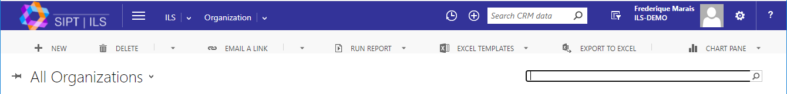
Global Search
There are two main free text search options within ILS.
Global Search
The global search - located in the main toolbar - searches the entire ILS system.
Local Search
By contrast, the local search field searches only what is on the current page.

Slide 5
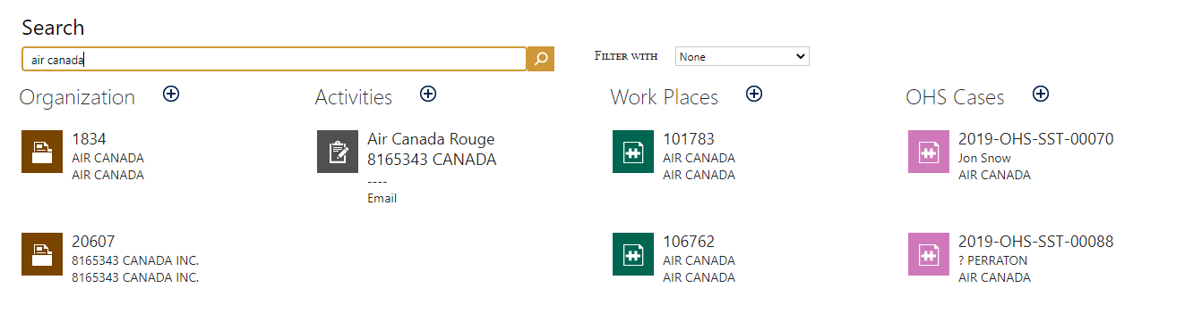
Global Search (Continued)
In the Global Search field, type your keyword then press Enter on your keyboard or select the magnifying glass icon. Your results are automatically categorized.
Your results are automatically categorized.

Slide 6

Global Search (Continued)
(Hover over image below to activate video play options.)
If you do not see the search bar in the main toolbar, simply select the magnifying glass to activate the search field.
The drop down menu next to "Filter With" allows you to narrow your search results to a specific category.

Slide 7
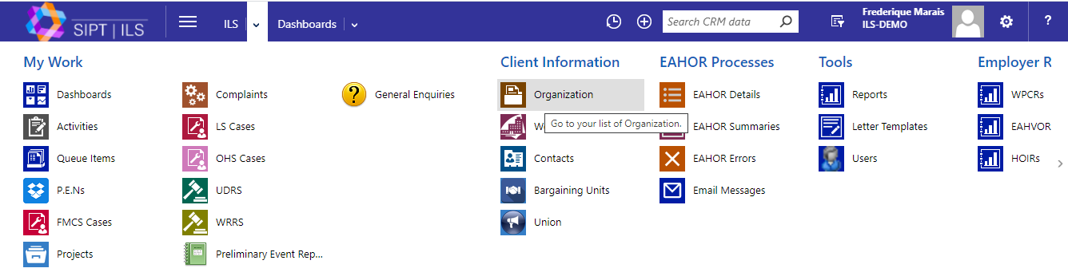
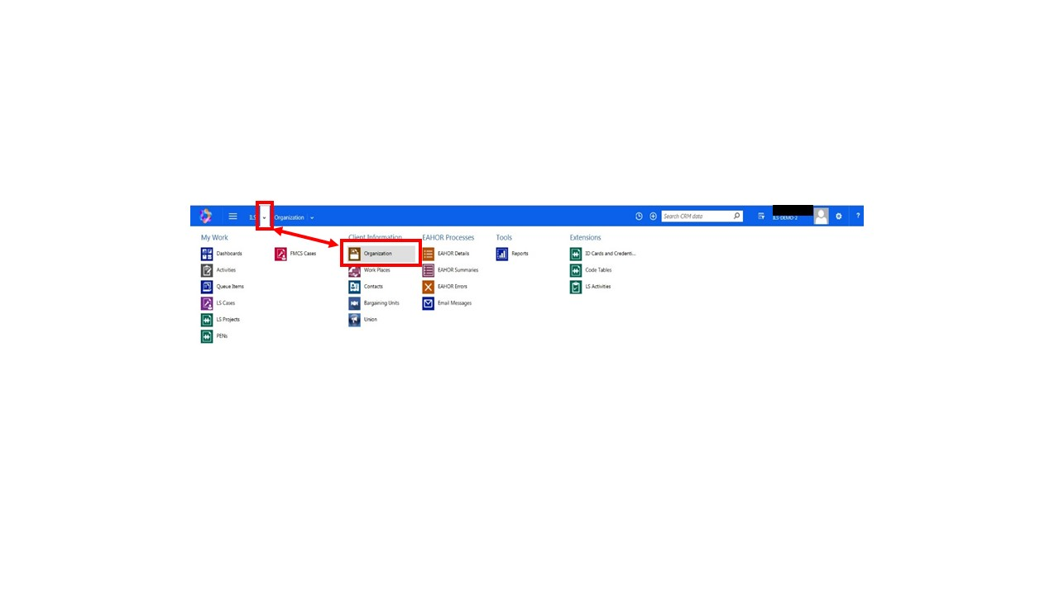
Local Search
To perform a local search, first navigate to the desired category using the dropdown arrow next to ILS. As an example, select Organization from the list of options.

Slide 8
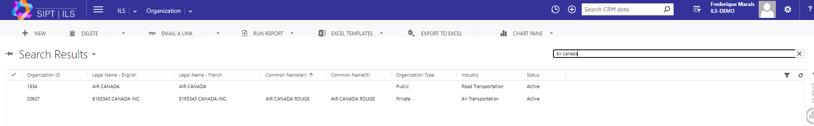
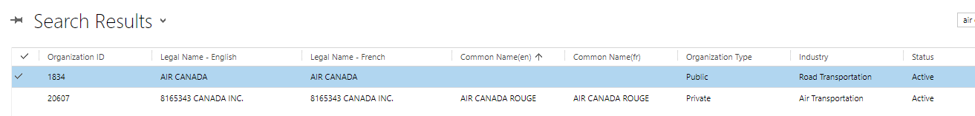
Local Search (continued)
Enter your search criteria in the local seach bar.
All corresponding results under the organization category will display. Simply select the one you want to access its contents.

Slide 9
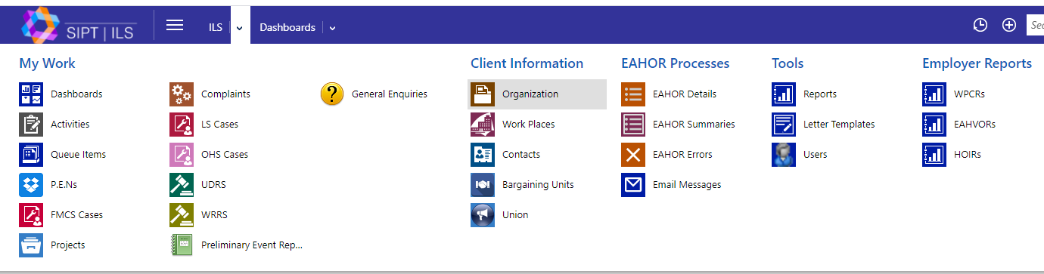
Using Chart Drill-Downs
The built-in Charts feature allows you to filter multiple search results using data embedded in the content. This process is called "drilling down". It is a staged approach of moving from a more general overview of data to a more specific one.
To demonstrate this, let's begin by selecting Organizations from the ILS Main Menu followed by Active Organizations.

Slide 10
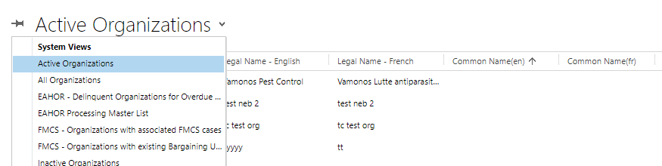
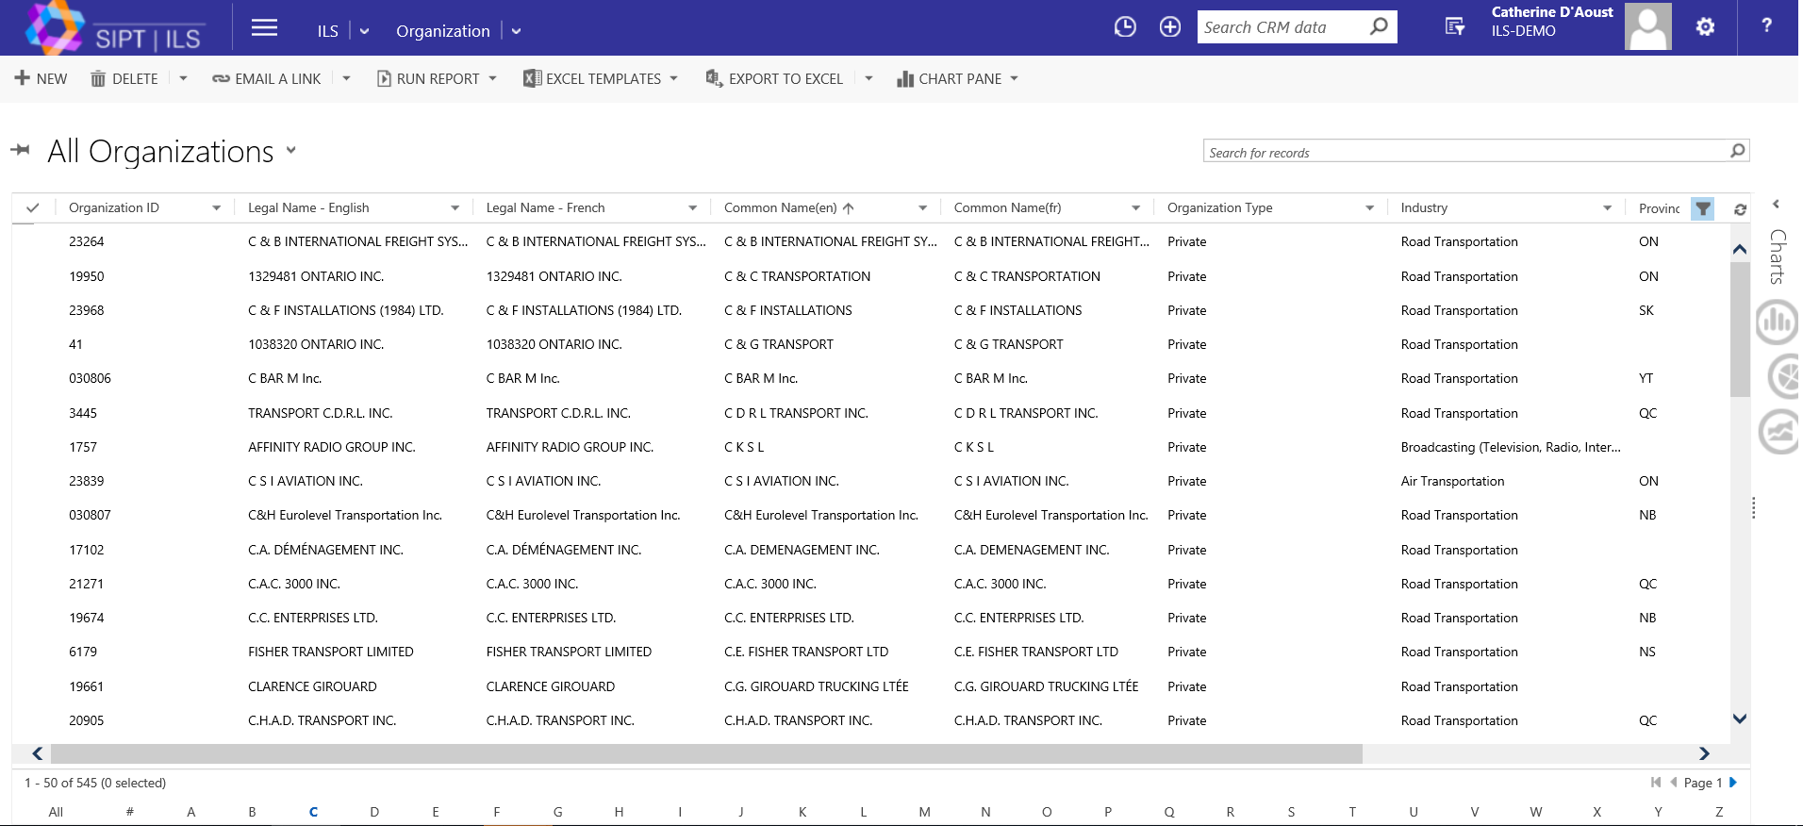
Using Chart Drill-Downs (continued)
The current list now contains all Organizations categorized as "active" in the ILS system.
Now, let's expand and display the Charts feature by selecting the arrow on the horizontal Charts bar, located on the extreme, right side of the window.

Slide 11
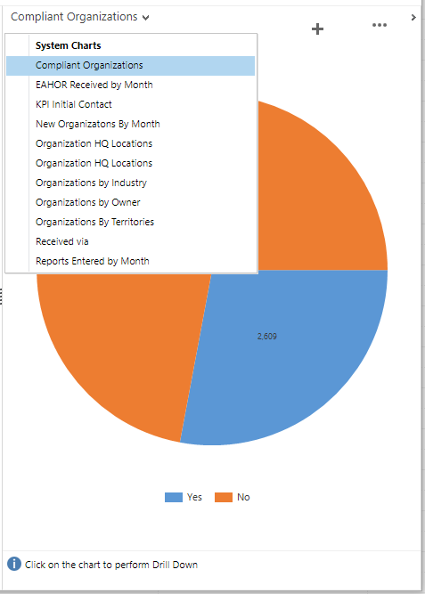
Using Chart Drill-Downs (Continued)
Once the Chart feature is displayed, use the drop-down menu at the top of the section to select the type of filter you would like to apply to your results list.
Ex: to view only organizations that are qualified as "compliant" in the system, select Compliant Organizations, from the System Charts drop-down menu.
A pie chart appears, indicating the number of active organisations that are compliant and non-compliant. Using the legend below the chart as a guide, selecting the Yes pie slice will automatically filter out all non-compliant organizations from our list of results
Legend

Slide 12
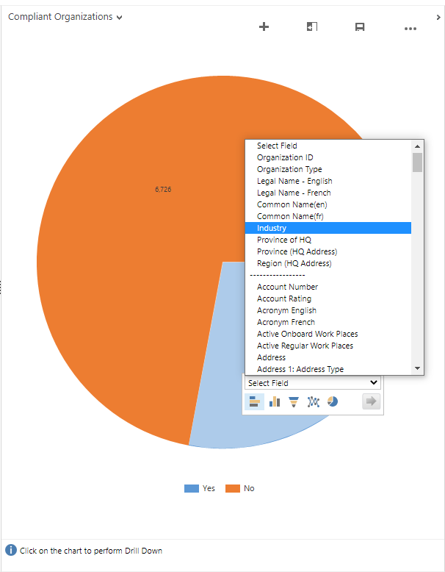

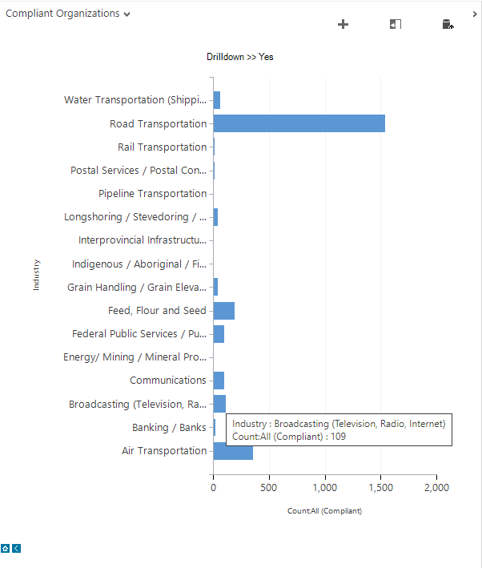
Using Chart Drill-Downs (Continued)
The Yes pie slice is highlighted, a field selector appears with a drop down menu, allowing us to breakdown the current results even further.
For example, by selecting "Industry" from the drop-down (followed by the OK button), a new graph appears, displaying a list of industries, with a break-down of where our Compliant Organizations fit in.

Slide 13
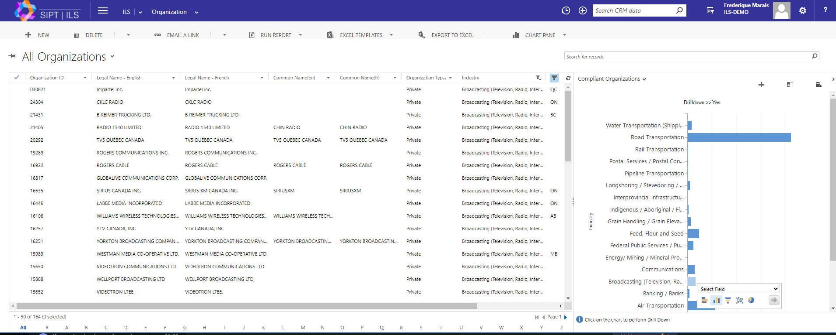
Using Chart Drill-Downs (Continued)
When a specific industry is highlighted (ex: Broadcasting), the results list will again filter down, now displaying only organizations designated as compliant from the broadcasting industry.

Slide 14
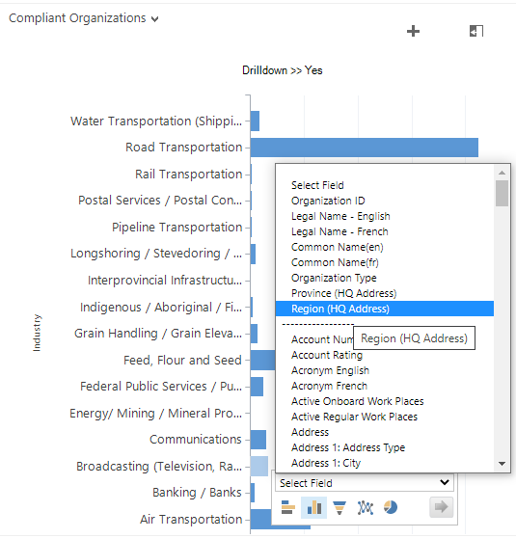

Using Chart Drill-Downs (Continued)
We can drill even further down our results by launching a new search field from the current options.
For example, if we select the Broadcasting bar from the list of industries, a new Select Field box will appear. If we navigate to Region (HQ Address) followed by the "OK" arrow key, the current list will be further broken down by region.
This drill-down action can be repeated several times, narrowing results until only those meeting very precise criteria are displayed.

Slide 15
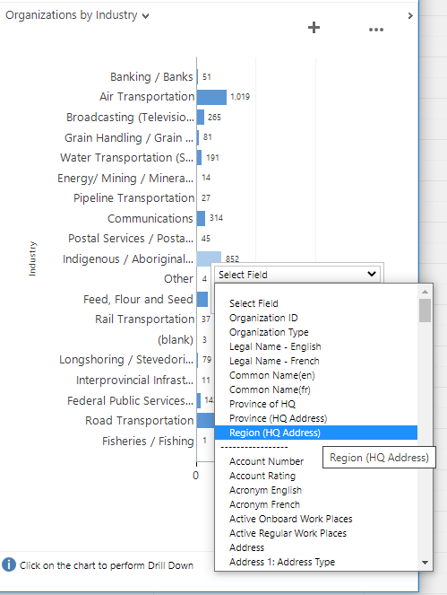
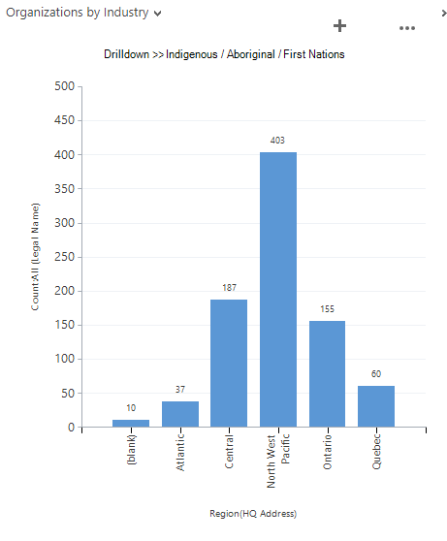
Using Chart Drill-Downs (Continued)
It is important to note that two types of information are listed in the Select Field option.
The first section is categorical, meaning selecting one of these options will generate a new chart displaying the different categories within that option, and the number of results for each.
Numbers per region
For example, selecting Region (HQ Address) from the first section, will produce a new chart that displays all of the different regions that contain Active Organisations, and the number of organisations that exist in each region.
Categorical
Binary
Regions

Slide 16
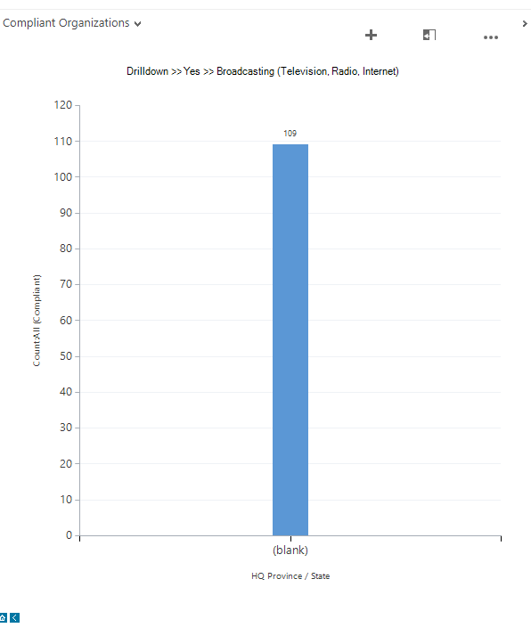
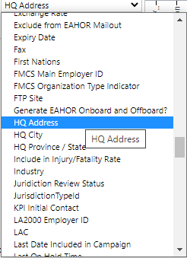
Using Chart Drill-Downs (Continued)
By contrast, the lower section of the Select Field list is Binary (i.e. "yes" or "no"), meaning the resulting chart will display one bar, showing the number of Active Organizations that meet that criteria.
Ex: Selecting HQ Address from the lower, binary section will show the number of Active Organizations that have the HQ Address field populated, however, it will not show you the addresses themselves.
Number of results that have an HQ address
Binary

Slide 17
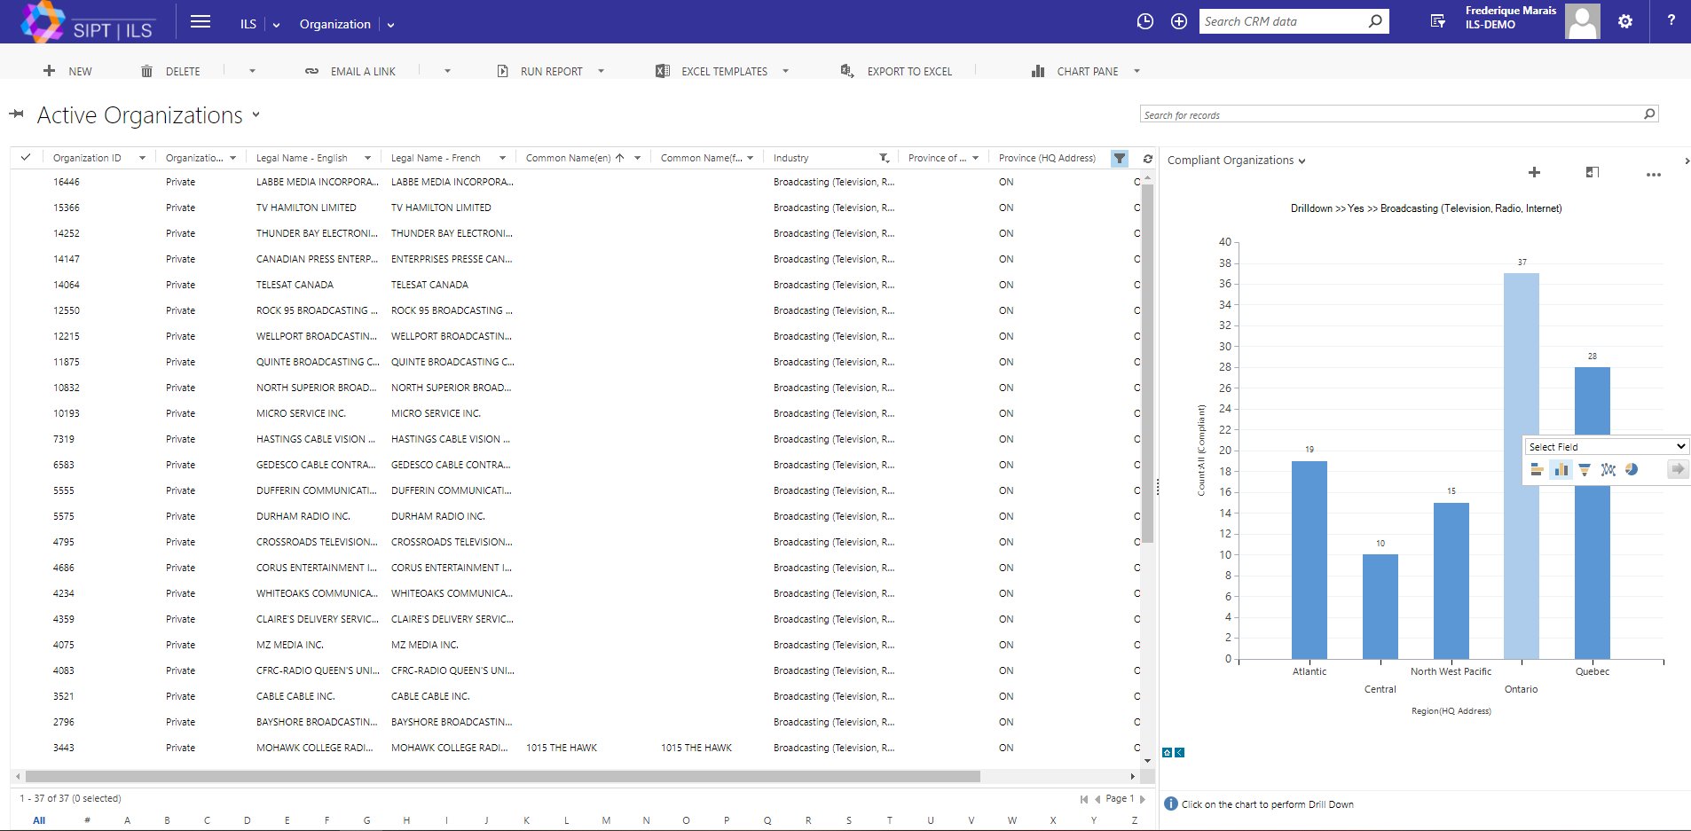
Navigation Records
Highlighting a specific bar on the graph will eliminate all search results that do not meet that criteria.
To unselect a bar, select a blank spot anywhere in the chart
Blank spot
There is a small toolbar in the bottom section of the chart. Select the arrow icon to go to the previous chart, or the home icon to start over.

Slide 18
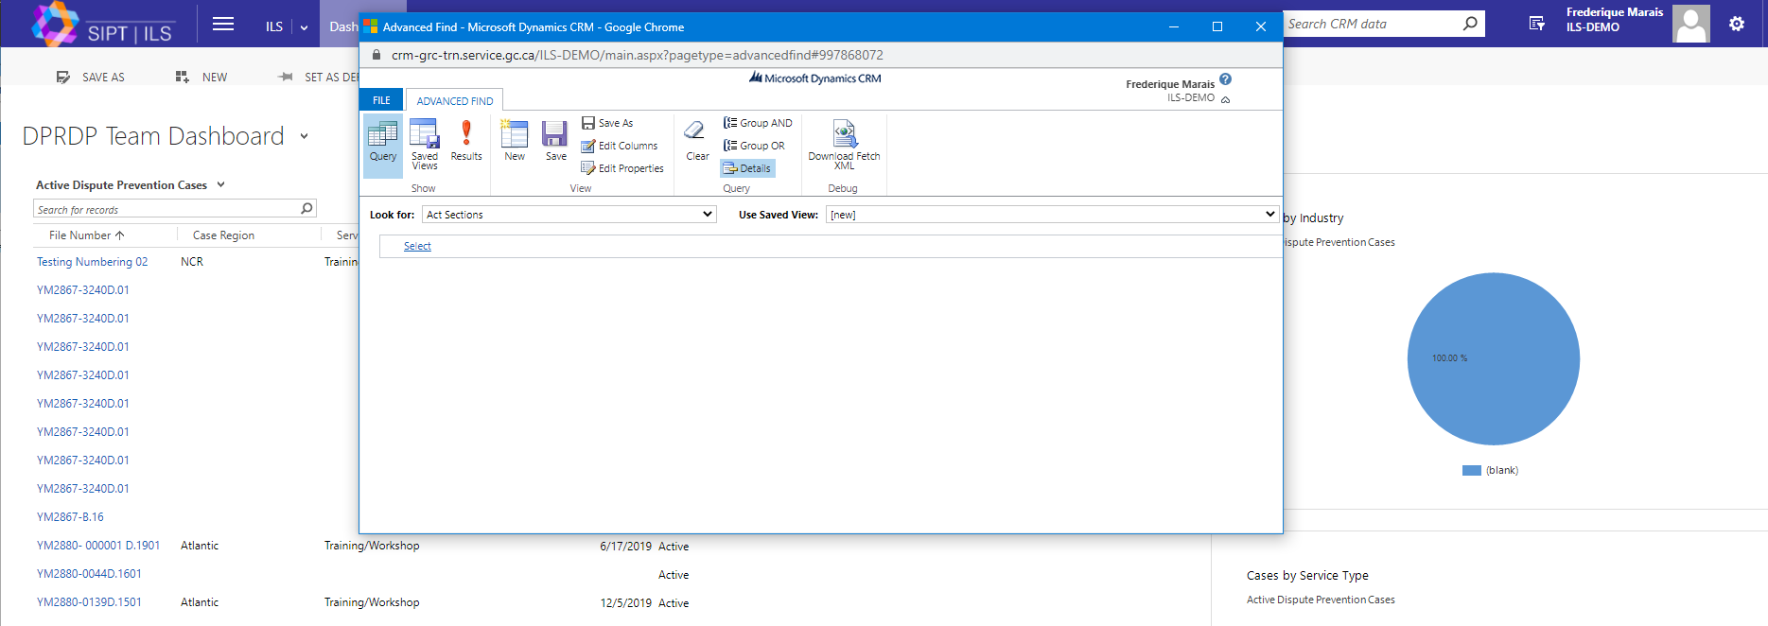
Advanced Find
The ILS Advanced Find command allows you to perform advanced searches across the ILS platform.
To access it, select the Advanced Find icon located to the right of the search icon. A pop-up box will appear.

Slide 19
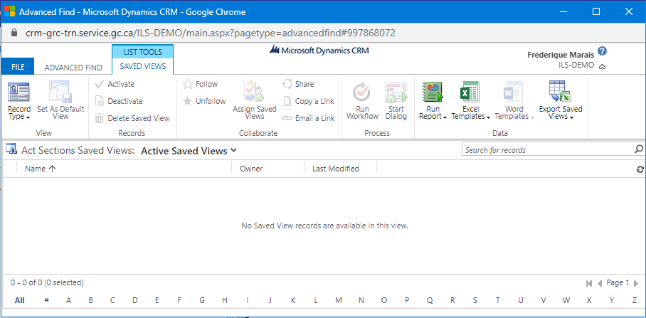
Advanced Find (Continued)
The Advanced Find window contains three tabs:
File
Advanced Search
List tool/saved views

Slide 20
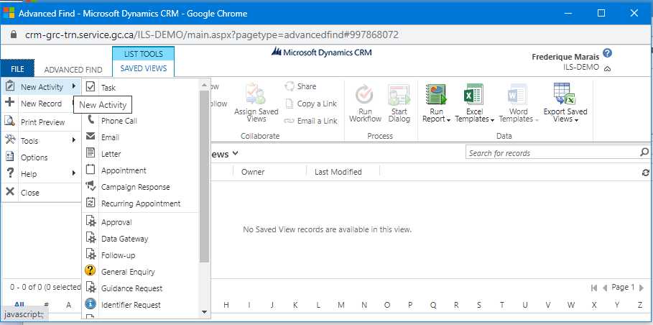
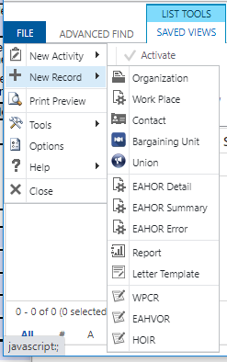
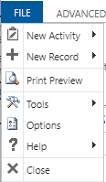
Advanced Find (Continued)
The File tab contains a list of actions that can be performed from this menu, such as launching a New Activity (i.e. creating a new Task or General Enquiry), or creating a new Record (ex: for a new Organization or Workplace).
Other commands listed are quick links to some of the ILS system's main tools including the Print Preview and the ILS account Options command.

Slide 21
Advanced Find (Continued)
The Advanced Find tab offers several options such as creating and saving advanced searches, and editing the view of your results. To perform an Advanced find, we need to assign a set of search criteria.
Let' s begin by selecting an category from the Look for drop-down menu. There are many options to choose from, but for this example, we will use OHS Cases. Next, we can select from the Use Saved View drop-down list. This list contains common, pre-existing search clauses. This is also where you will find any searches you choose to save. For now, let's add Active OHS Cases from the existing list.
Category
Qualifier
Value
Notice that the conditions of the search query we selected are now listed below, identifying that we are searching for results for which the Status field is defined as Active (i.e. Equals - Active).

Slide 22
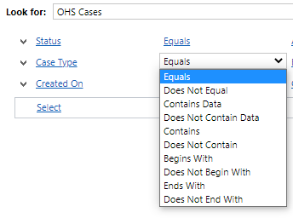
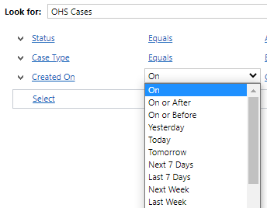
Advanced Find (Continued)
You'll notice you can add other clauses to your search by using the Select command to select a category, adding a search field. Let's choose Case Type.
A default qualifier, Equals, automatically appear to the right of your selected category. This can be changed by activating the drop-down. The options in the qualifier list will change depending on the type of information being requested.
If, for example, we were to select Created On, we see that the qualifier options change to reflect that selection. In this case, they serve to qualify a time period.

Slide 23
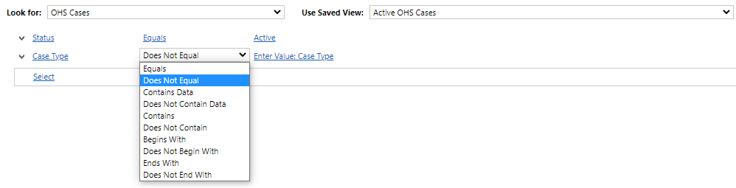
Advanced Find (Continued)
In the first command, when looking for OHS Cases, the qualifier used was Equals and the value was Active, meaning we wanted to include all OHS Cases that qualified as being Active.
Qualifiers can also be also be used to omit results.
We can examine this by selecting Does not equal as the Case Type qualifier

Slide 24
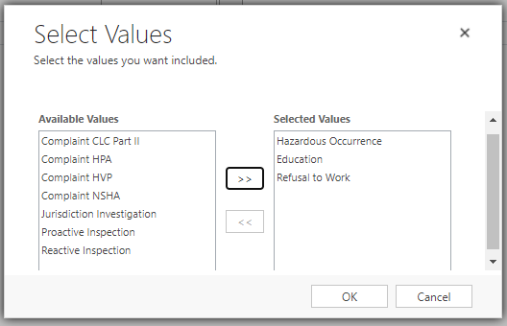
Advanced Find (Continued)
When we activate the drop-down, a Select Values pop-up window appears. From here, we can select which case types we DO NOT want included in our search results by moving them from the Available Values list to the Selected Values box.
This can be done by double-clicking the items or highlighting them and using the arrow keys to move them between the boxes before selecting OK. Let's explore this by adding Education, Hazardous Occurrence, and Refusal to Work to the to the Selected Values box

Slide 25
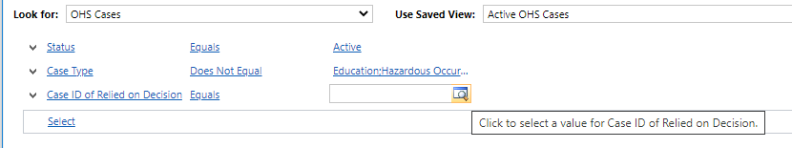
Advanced Find (Continued)
Certain search selections will provide a Look Up Records option, allowing you to search for specific existing criteria.
For example, by selecting Case ID of Relied on Decision, a look-up icon will appear in the Value field. Selecting the look-up icon will launch a pop-up window. From here, simply search for and specify which CASE ID you wish to add.

Slide 26
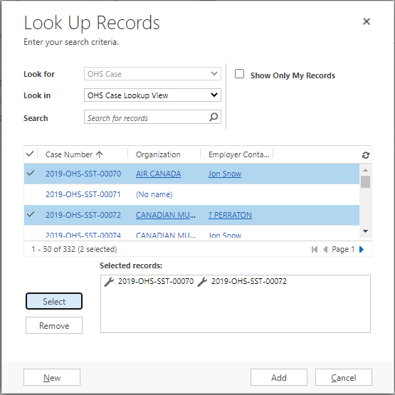
Advanced Find (Continued)
To choose an option from the Look up Records window, be sure to activate the check box on the left and use the Select button to add it to the Selected Records box.
Selecting the item rather than using the checkbox will launch the records in a separate window. It will not be added to the Selected records box

Slide 27
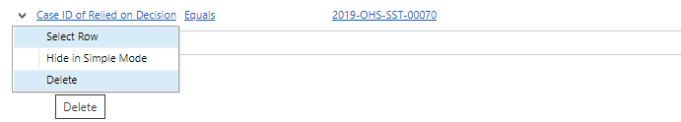
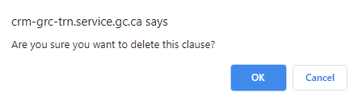
Advanced Find (Continued)
At any time, you can edit your search criteria [demonstrate moving between the different options] or delete them using their respective drop-downs [demonstrate removing Case ID of Relied on Decision]
You will be prompted to confirm the deletion. Simply select "OK".

Slide 28
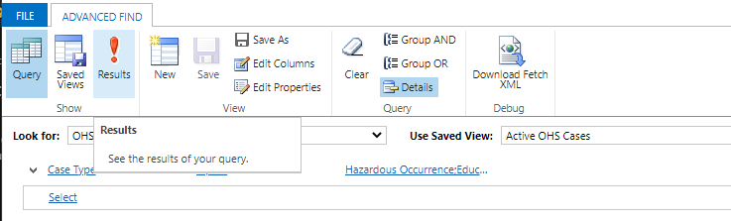
Advanced Find (Continued)
To view the results of your search, select the Results button under the Advanced Find tab

Slide 29
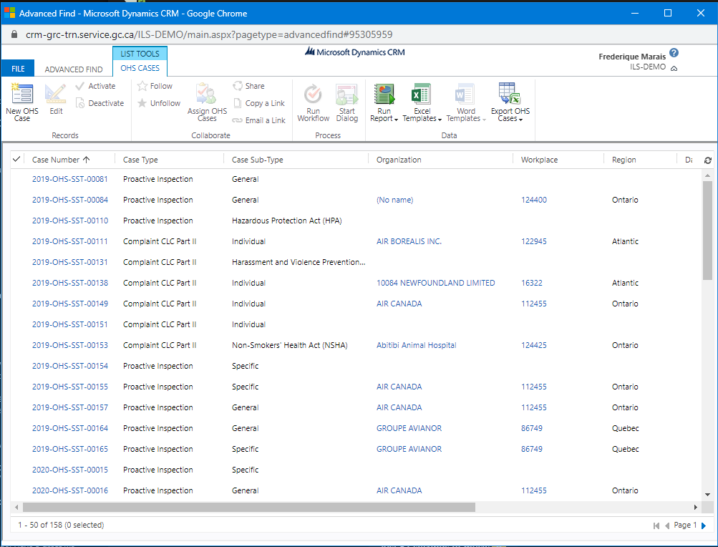
Advanced Find (Continued)
The resulting list displays all active OHS cases, excluding those related to Education, Hazardous Occurrences, and Refusal to Work.

Slide 30
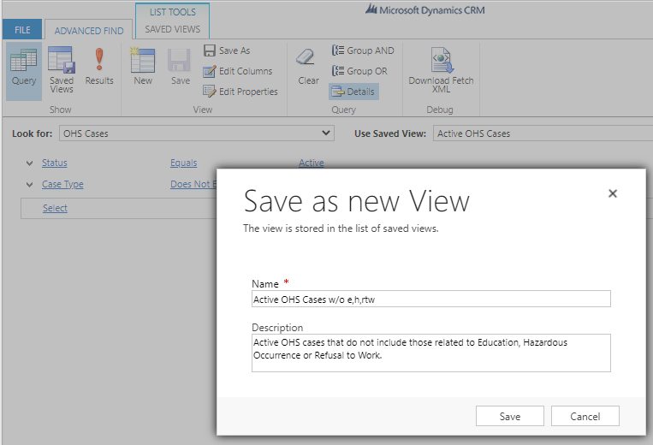
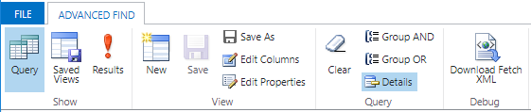
Advanced Find (Continued)
Searches that you perform frequently can be saved as for future use. To do this, select Save As under the Advanced Find tab. A Save as new View pop-up box will appear. Provide it with a name and description, and select Save.
To access your saved search commands, select the Saved Views button under the Advanced Find tab.

Slide 31
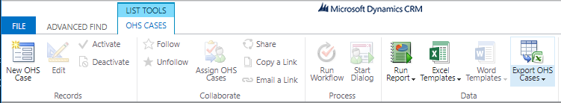
Exporting
Search results can be exported to a Excel using the Export button at the end of the ribbon under List Tools tab.
Select to export list

Slide 32
ILS
Integrated Labour System
End of Module 3
Training Program

